Slide 1
Project Report
Title: Sales Performance Analysis of Walmart Stores Using Advanced MySQL Techniques
Video Link : https://drive.google.com/file/d/1EVL5y2svSt-4xTiZUHcZMW6n7epwYhmB/view?usp=drive_link
Presented by
Shashwat Gupta

Slide 2
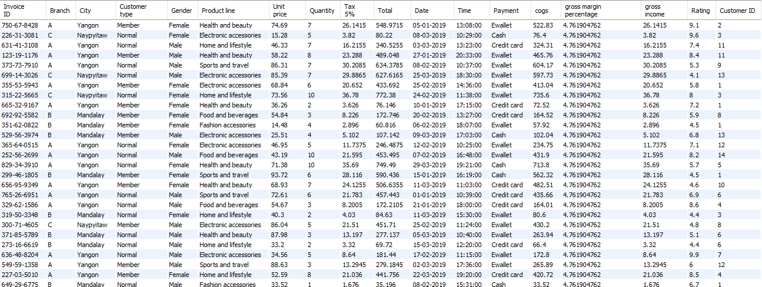
Dataset:
Walmart Sales Data

Slide 3

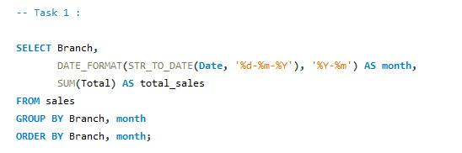
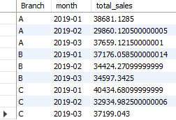
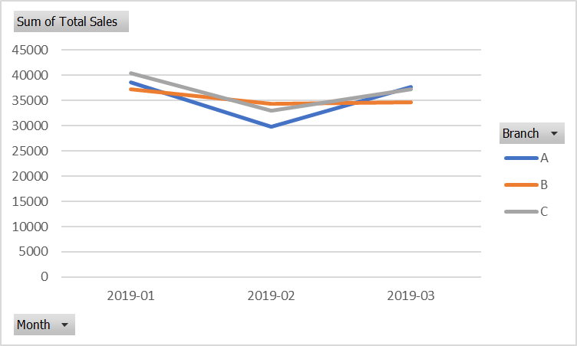
Task 1:
Identifying the Top Branch by Sales Growth Rate
SQL Query
Result Table
Result Analysis:
Branch A has shown the highest sales growth rate over the observed period. This indicates strong market traction or effective promotions. Branch C showed moderate growth, while B was relatively stable.

Slide 4
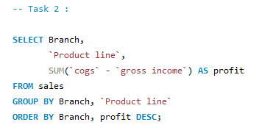
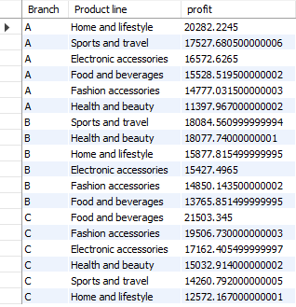
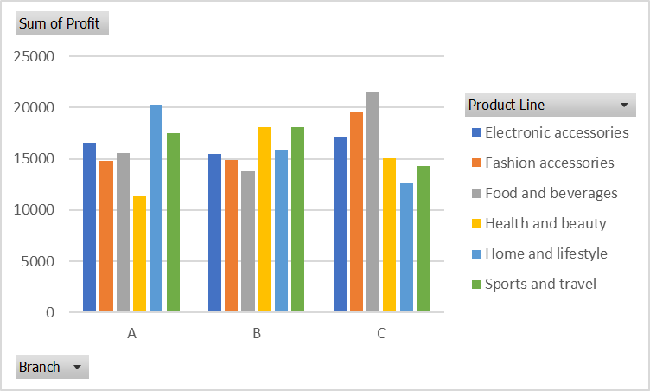
Task 2:
Finding the Most Profitable Product Line for Each Branch
SQL Query
Result Table
Result Analysis:
Branch A: Home and Lifestyle is the most profitable.
Branch B: Health and Beauty leads.
Branch C: Food and Beverages dominates.
This suggests customer preferences vary by location. Walmart can tailor stock and promotions accordingly.

Slide 5
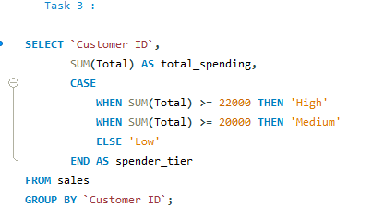
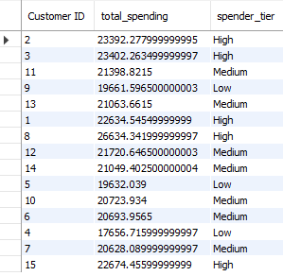
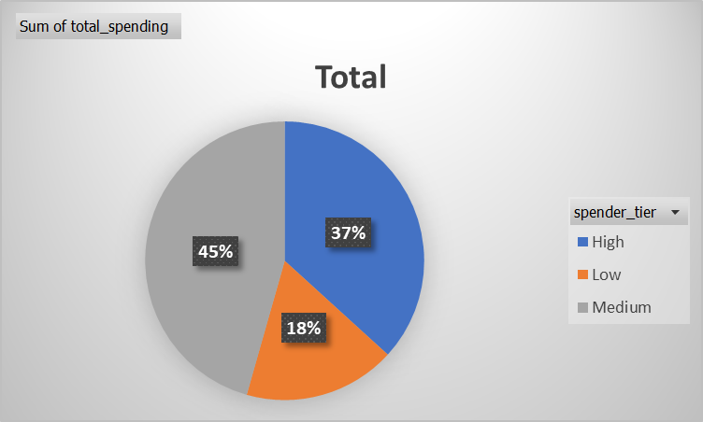
Task 3:
Analyzing Customer Segmentation Based on Spending
SQL Query
Result Table
Result Analysis:
Customers are segmented into:
High spenders (top 30%)
Medium (middle 50%)
Low (bottom 20%)
Majority fall into the medium tier, but high spenders contribute a disproportionate share of revenue. Focused loyalty programs for high-tier customers may yield high ROI.

Slide 6
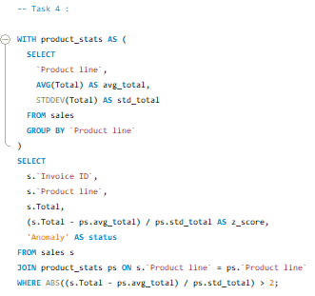
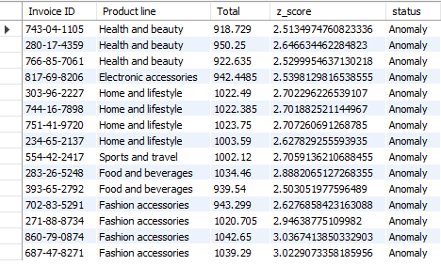
Task 4:
Detecting Anomalies in Sales Transactions
SQL Query
Result Table
Result Analysis:
Anomalies were identified as transactions with sales far above or below the average for their product line. These may represent bulk purchases or errors. Branch managers should review outliers for potential fraud or reporting issues.

Slide 7
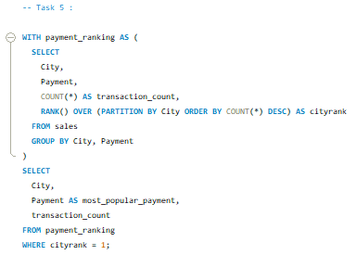

Task 5:
Most Popular Payment Method by City
SQL Query
Result Table
Result Analysis:
Yangon: Most use Ewallet.
Naypyitaw: Credit Card dominates.
Mandalay: Customers prefer Cash.
Walmart can tailor promotions (e.g., cashback) by city to boost engagement.

Slide 8
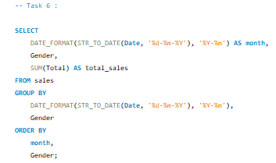
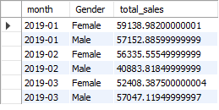
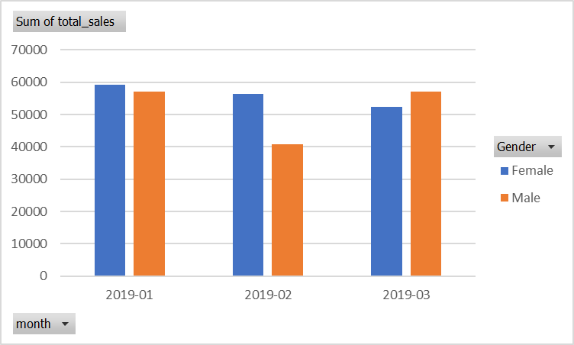
Task 6:
Monthly Sales Distribution by Gender
SQL Query
Result Table
Result Analysis:
Sales are nearly equally split between male and female customers across months, though some months show slight male dominance. Gender-balanced marketing works, but short-term gender-targeted promotions can help optimize peak months.

Slide 9
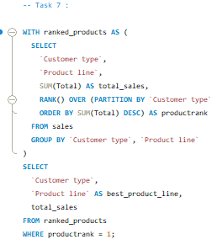

Task 7:
Best Product Line by Customer Type
SQL Query
Result Table
Result Analysis:
Members: Prefer Food and Beverages.
Normal Customers: Prefer Electronic Accessories.
Membership programs could promote high-margin products to loyal buyers.

Slide 10
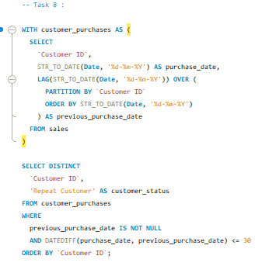
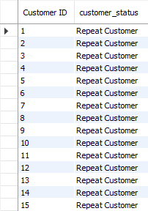
Task 8:
Identifying Repeat Customers
SQL Query
Result Table
Result Analysis:
Repeat purchases within 30 days were identified. These customers are highly valuable and responsive. Targeted emails or loyalty benefits can help retain and upsell them.

Slide 11
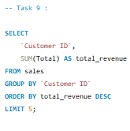
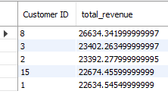
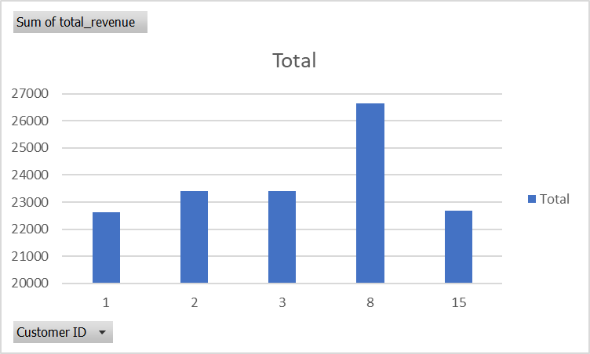
Task 9:
Finding Top 5 Customers by Sales Volume
SQL Query
Result Table
Result Analysis:
The top 5 customers contribute significantly to total revenue.
Walmart should reward these customers to retain them.

Slide 12
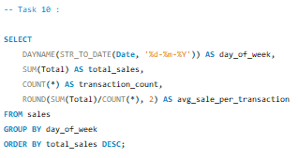
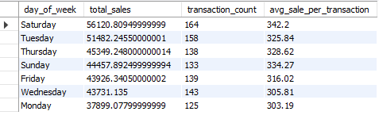
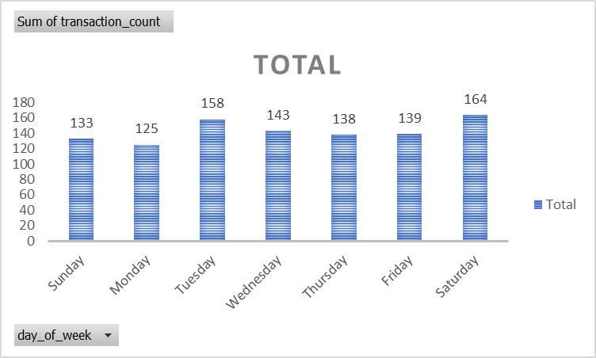
Task 10:
Analyzing Sales Trends by Day of the Week
SQL Query
Result Table
Result Analysis:
Sales peak on Saturdays and are lowest on Mondays. Weekends are critical, suggesting the need for more inventory, staff, and promotions during this time.

